Slide 1

Working procedure of black box model recommedation
12 initial samples
(including 12 different combinations of
enzymes and Limonene concentrations)
model training procedure
model training procedure
model training procedure
get recommendation combinations of enzymes
6 samples
get recommendation combinations of enzymes
6 samples
get recommendation combinations of enzymes
experiment the recommendations and get Limonene concentrations
experiment the recommendations and get Limonene concentrations
Cycle 1
Cycle 1
Cycle 1

Slide 2
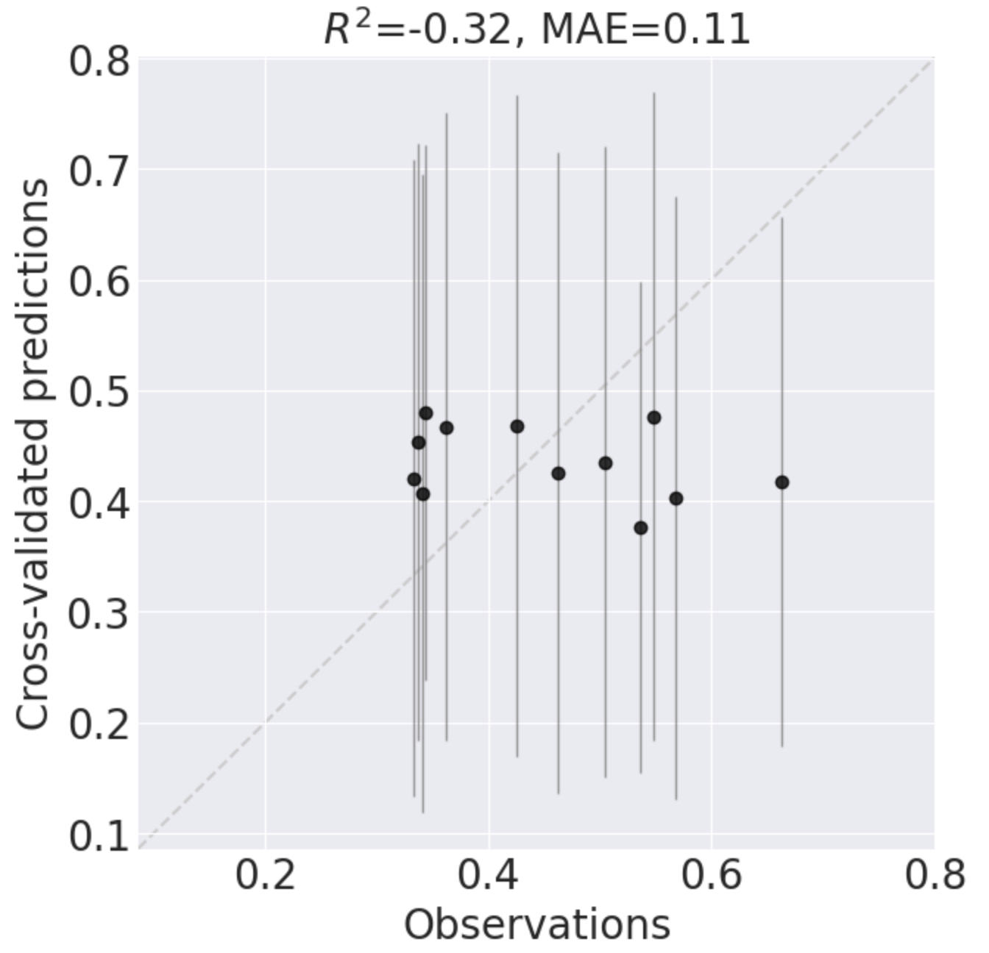
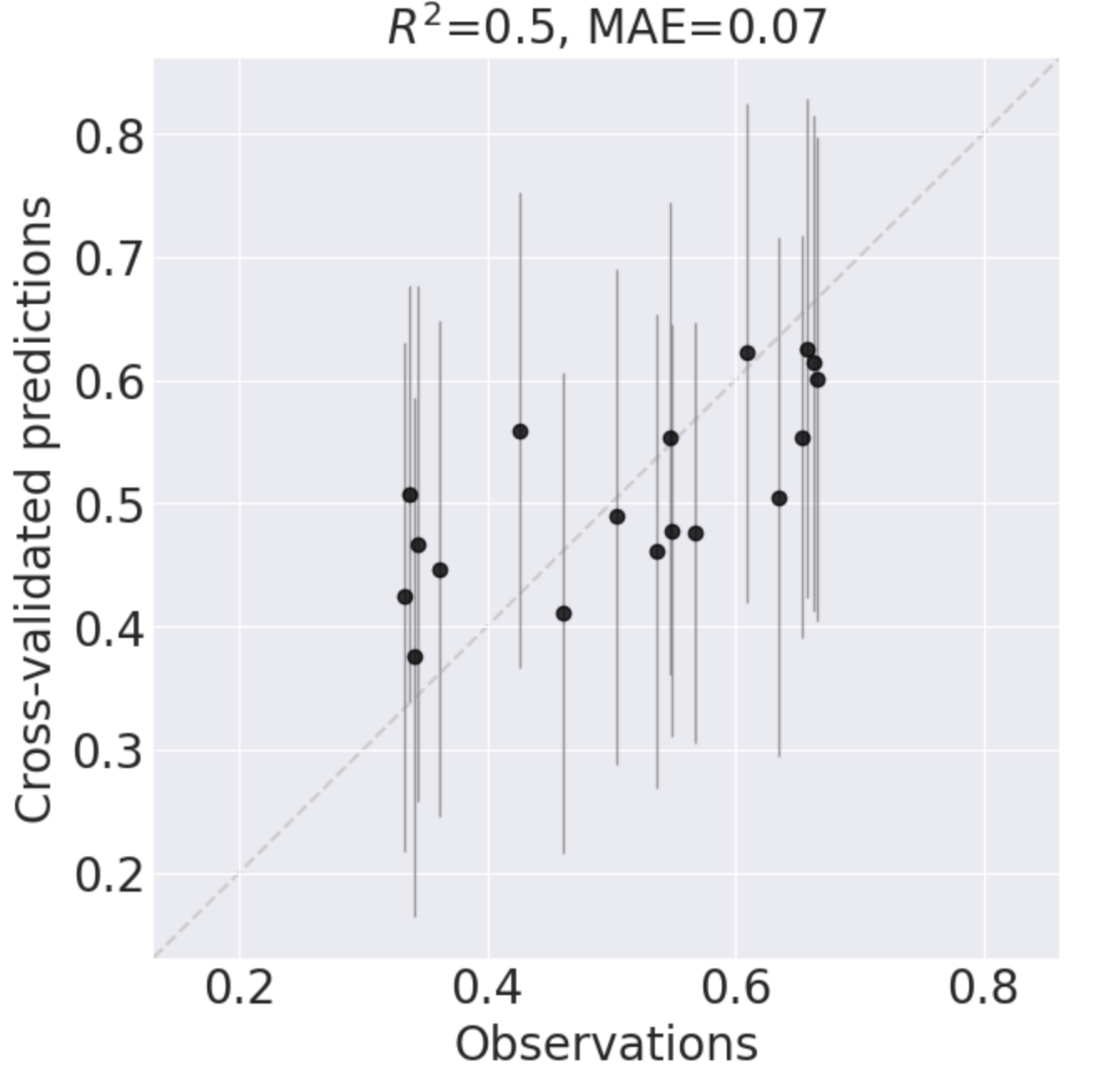
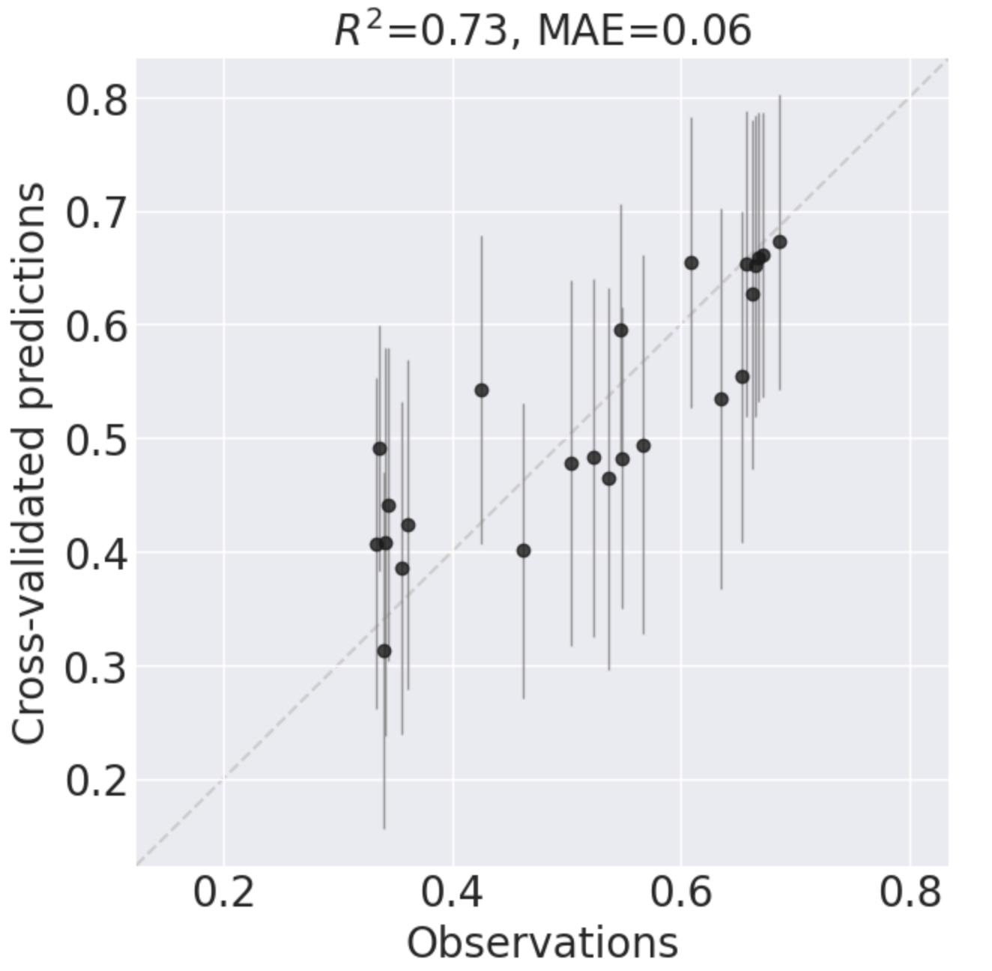
Model training procedure cross-validation result
Cycle1
Cycle2
Cycle3
$R^{2}$ keeps improving from -0.32 to 0.5 then to 0.73

Slide 3
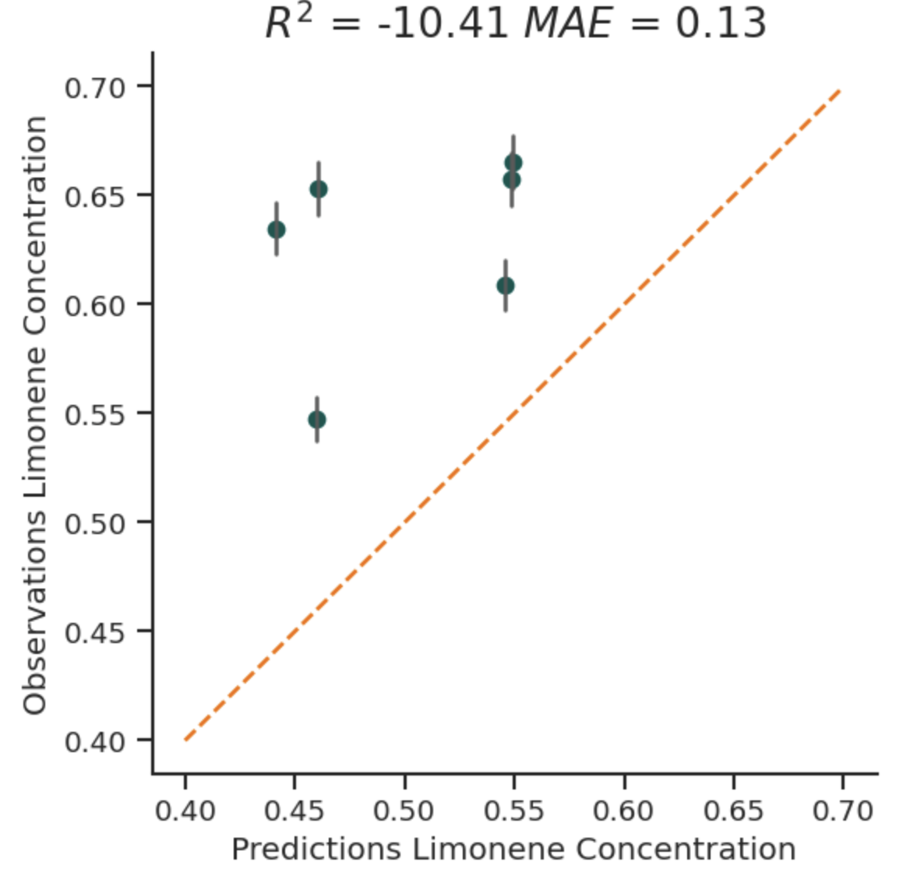
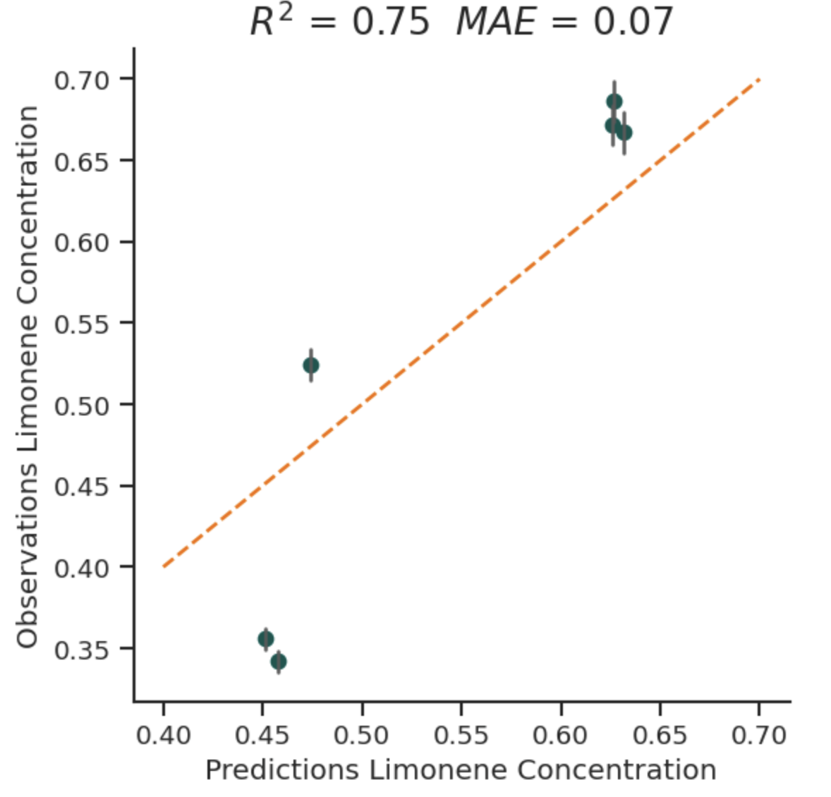
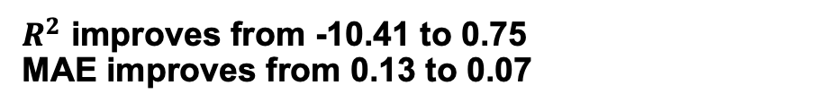
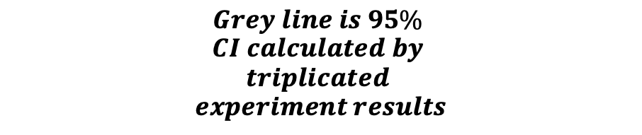
Prediction of recommendations VS Experiment results
Cycle1
Cycle2
$$Grey line is 95\%$$
$$CI calculated by$$
$$triplicated$$
$$experiment results$$
$R^{2}$ improves from -10.41 to 0.75
MAE improves from 0.13 to 0.07

Slide 4
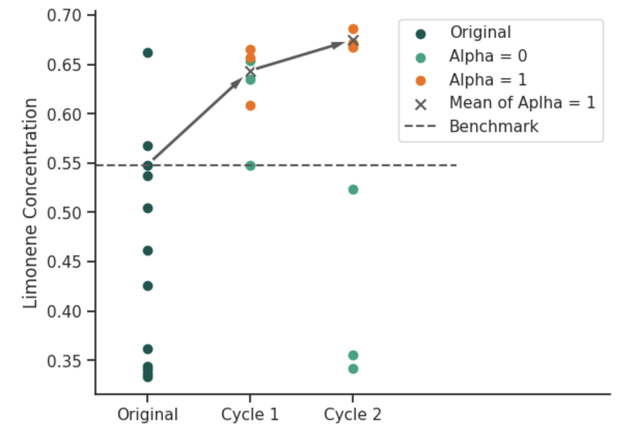
Improving of Limonene concentration among different cycles
Benchmark is the Limonene concentration of wild type combinations from the 12 original samples

